Slide 1

APPLICATIONS OF ICT
WEEK 7
The Internet Protocol Suite, DHCP,
Private IP Addresses & Network Address Translation
Lectures 13 — 14

Slide 2
LEARNING ROADMAP
01
The Internet Protocol Suite
05
Application Layer
TCP/IP model, layers, OSI comparison
HTTP, FTP, SMTP, DNS and more
02
Link Layer
06
Dynamic Host Configuration Protocol
Physical transmission, framing, MAC addressing
DHCP, DORA process, lease management
03
Internet Layer
07
Private IP Addresses
IP protocol, routing, ICMP, ARP
RFC 1918, reserved address ranges
04
Transport Layer
08
Network Address Translation
TCP, UDP, segmentation, flow control
Static NAT, Dynamic NAT, PAT
LECTURES 13 — 14
This week covers the complete TCP/IP protocol suite,
DHCP operation, and IP address management with NAT.
02

Slide 3

01
CHAPTER 01
The Internet Protocol Suite
Understanding the foundation of modern
network communication

Slide 4
The TCP/IP Model — Four Layers of Communication
CHAPTER 01
The Internet Protocol Suite (TCP/IP) is a collection of communication protocols that forms the foundation of the Internet, organized into four layers with specific responsibilities.
4
Application Layer
Interfaces with user applications. Protocols: HTTP, FTP, SMTP, DNS. Handles data formatting, encryption, and session management.
3
Transport Layer
Ensures reliable data delivery. Protocols: TCP, UDP. Manages segmentation, flow control, error checking, and port-based multiplexing.
2
Internet Layer
Handles addressing and routing. Protocols: IP, ICMP, ARP. Manages logical addressing, packet routing, and fragmentation.
1
Link Layer
Manages physical transmission. Technologies: Ethernet, Wi-Fi, PPP. Handles framing, error detection, and MAC addressing.
04

Slide 5
TCP/IP vs OSI Model — A Comparative View
CHAPTER 01
Feature | OSI Model | TCP/IP Model
Layers | 7 layers | 4 layers
Approach | Theoretical reference model | Practical implementation model
Developer | ISO (International Organization) | U.S. Department of Defense
Protocols | Protocol-agnostic (generic) | Defines specific protocols (TCP, IP, HTTP)
Layer Boundaries | Strictly independent layers | More integrated, flexible layers
Usage | Teaching and reference framework | Actual Internet protocol stack
Key Mapping | Session + Presentation + Application | All combined in Application Layer
Key Insight: Both models use layered architecture to separate concerns and simplify troubleshooting. The TCP/IP model is what actually powers the Internet today.
05

Slide 6
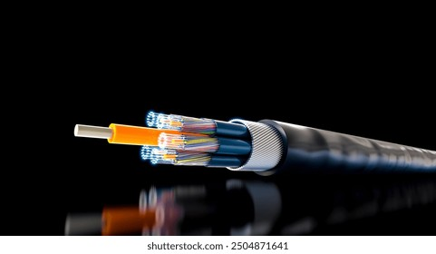
02
CHAPTER 02
Link Layer
Physical transmission and local
network communication

Slide 7
Link Layer — The Physical Foundation
CHAPTER 02
Physical Transmission
ETHERNET FRAME STRUCTURE
Sends and receives raw bits over physical media: Ethernet cables, fiber optics, Wi-Fi
Preamble
7 bytes
Dest MAC
6 bytes
Src MAC
6 bytes
Type
2 bytes
CRC/FCS
4 bytes
Framing
Organizes data into frames for proper transmission and recognition by devices
Payload Data (46 - 1500 bytes)
Error Detection
Detects transmission errors using checksums or CRC (Cyclic Redundancy Check)
Total frame size: 64 to 1,518 bytes
MAC addresses are 48-bit hardware addresses burned into NICs
MAC Addressing
Uses hardware addresses (48-bit) to identify devices within the same network segment
Access Control
Determines how multiple devices share the same physical medium, avoiding collisions
07

Slide 8
Link Layer Protocols & Technologies
CHAPTER 02
Ethernet (IEEE 802.3)
Wi-Fi (IEEE 802.11)
PPP
The most widely used wired LAN technology. Uses CSMA/CD (Carrier Sense Multiple Access with Collision Detection) to manage shared medium access. Supports speeds from 10 Mbps to 400 Gbps.
Wireless LAN technology using CSMA/CA (Collision Avoidance). Operates in 2.4 GHz and 5 GHz bands. Standards include 802.11a/b/g/n/ac/ax (Wi-Fi 6) with speeds up to 9.6 Gbps.
Point-to-Point Protocol for direct connections between two nodes. Commonly used for dial-up and VPN connections. Provides authentication, encryption, and compression.
ARP
Key Characteristics
Address Resolution Protocol maps IP addresses (32-bit) to MAC addresses (48-bit). Uses ARP request (broadcast) and ARP reply (unicast). Maintains an ARP cache table for recent mappings. Essential for delivering packets within the same local network segment.
■ Operates within a single network segment
■ Uses physical (MAC) addresses, not IP addresses
■ Responsible for hop-to-hop delivery
■ Detects but does not correct errors
■ Manages media access to prevent collisions
08

Slide 9

03
CHAPTER 03
Internet Layer
Addressing, routing, and packet delivery
across networks

Slide 10
Internet Layer — Routing Data Across Networks
CHAPTER 03
Logical Addressing
Packet Routing
Assigns IP addresses to identify source and destination devices globally across interconnected networks.
Determines the best path for data to travel across interconnected networks using routing algorithms and routing tables.
Fragmentation & Reassembly
Protocol Support
Breaks large packets into smaller fragments for transmission and reassembles them at the destination.
Primarily uses IP, along with ICMP for error reporting and ARP for address resolution.
IP DATAGRAM STRUCTURE
KEY RESPONSIBILITIES
Version
4 bits
Header Len
4 bits
TOS
8 bits
Total Length
16 bits
■ Host-to-host communication across networks
■ IP addressing (IPv4: 32-bit, IPv6: 128-bit)
■ Packet formatting into IP datagrams
■ Fragmentation for different MTUs
■ Routing decisions via routing tables
■ Best-effort delivery (no guarantees)
Identification
16 bits
Flags
3 bits
Frag Offset
13 bits
TTL
8 bits
Protocol
8 bits
Checksum
16 bits
Source IP (32 bits)
Destination IP (32 bits)
10

Slide 11
Internet Protocol (IP) — The Core of the Internet
CHAPTER 03
IP Addressing
Defines addressing conventions: IPv4 uses 32-bit addresses; IPv6 uses 128-bit addresses for expanded capacity.
IPv4 vs IPv6
IPv4
IPv6
Host-to-Host Communication
32-bit addresses
~4.3 billion addresses
Decimal notation
Example: 192.168.1.1
128-bit addresses
~3.4 x 10^38 addresses
Hexadecimal notation
Example: 2001:0db8::1
Determines the path a packet must take based on the receiving host's IP address and routing tables.
Packet Formatting
Assembles packets into IP datagrams with headers containing version, length, TTL, protocol, and addresses.
Note: When the term "IP" is used without version specification, the description applies to both IPv4 and IPv6. Most networks today run both protocols simultaneously (dual-stack).
Fragmentation
Breaks packets too large for network media into smaller fragments; reassembles them at the destination.
11

Slide 12
Supporting Protocols — ICMP & ARP
CHAPTER 03
ICMP
ARP
Internet Control Message Protocol
Address Resolution Protocol
Used for error reporting and diagnostic functions. ICMP messages are encapsulated in IP datagrams for delivery.
Conceptually exists between Link Layer and Internet Layer. Maps IP addresses to MAC addresses.
Common ICMP Messages
How ARP Works
Echo Request / Reply — Used by the ping utility to test connectivity between hosts
1. Host broadcasts ARP Request: "Who has this IP address?"
2. Target host replies with ARP Reply containing its MAC
Destination Unreachable — Sent when a packet cannot be delivered to its destination
3. Requesting host stores mapping in ARP cache table
Time Exceeded — Sent when TTL reaches zero, preventing packets from circulating indefinitely
The ARP cache stores recent IP-to-MAC mappings to reduce network traffic. Entries typically expire after a few minutes.
Essential for network troubleshooting and status communication between devices.
12

Slide 13

04
CHAPTER 04
Transport Layer
End-to-end reliable data delivery
between hosts

Slide 14
Transport Layer — Delivering the Complete Message
CHAPTER 04
Unlike the Internet Layer which handles individual packets, the Transport Layer delivers the complete message from source to destination.
Segmentation
Multiplexing
Error Detection
Breaks large messages into segments for transmission and reassembles them at the destination.
Uses port numbers to allow multiple applications to share the network simultaneously.
Verifies data integrity using checksums to ensure packets arrive uncorrupted.
Flow Control
Connection Management
Prevents the receiver from being overwhelmed by regulating the data transmission rate using sliding window mechanisms.
Establishes, maintains, and terminates connections between communicating hosts through handshake protocols.
Key distinction: While all network nodes need the Internet Layer, only the two end hosts need the Transport Layer — it is purely end-to-end.
14

Slide 15
TCP — Transmission Control Protocol
CHAPTER 04
CONNECTION-ORIENTED
TCP USE CASES
Three-Way Handshake
Web Browsing — HTTP/HTTPS requires complete, accurate page delivery
Establishes connection via SYN → SYN-ACK → ACK sequence before data transfer.
File Transfers — FTP requires every byte to arrive correctly
Reliable Delivery
Confirms packet receipt and automatically retransmits lost or corrupted data.
Email — SMTP, POP3, IMAP need reliable message delivery
Ordered Delivery
Sequences packets with sequence numbers so they can be reassembled in correct order.
Database Access — SQL queries require accurate results
Error Checking
Detects errors using checksums to ensure data integrity throughout transmission.
TCP header size: 20 bytes (minimum). Operates on port-based addressing with well-known ports (0-1023).
Flow Control
Uses sliding window mechanism to regulate data rate and prevent receiver overflow.
15

Slide 16
UDP — User Datagram Protocol
CHAPTER 04
CONNECTIONLESS
UDP USE CASES
No Connection Setup
Live Streaming — Real-time video where occasional loss is better than delay
Sends data immediately without establishing a connection — minimal overhead, maximum speed.
Online Gaming — Low latency is critical; missing frames are skipped
No Error Checking
Does not verify whether data has errors — applications handle reliability if needed.
VoIP Calls — Voice communication prioritizes speed over perfection
No Retransmission
Lost or damaged data is not resent — acceptable for real-time applications.
DNS Queries — Quick lookups where a retry is faster than TCP setup
Lightweight & Fast
Smaller header (8 bytes) and fewer resources — ideal for high-speed applications.
UDP header: only 8 bytes (Source Port, Dest Port, Length, Checksum). Much smaller than TCP's 20 bytes.
16

Slide 17
TCP vs UDP — Choosing the Right Protocol
CHAPTER 04
Feature | TCP | UDP
Connection | Connection-oriented | Connectionless
Reliability | Guaranteed delivery | Best-effort, no guarantee
Ordering | Ordered packet delivery | No ordering guarantee
Error Check | Checksum + retransmission | Optional checksum only
Flow Control | Sliding window mechanism | None
Header Size | 20 bytes | 8 bytes
Speed | Slower (overhead) | Fast (minimal overhead)
Use Cases | Web, email, file transfer | Streaming, gaming, VoIP, DNS
Choose TCP When:
Choose UDP When:
Data completeness is critical — web pages, files, emails, financial transactions, database queries.
Speed and low latency matter most — live video, online gaming, voice calls, real-time monitoring.
17

Slide 18

05
CHAPTER 05
Application Layer
User-facing protocols and
network services

Slide 19
Application Layer — The User Interface to Networks
CHAPTER 05
The Application Layer is the topmost layer, closest to the user. In TCP/IP, it combines the functions of OSI's Session, Presentation, and Application layers.
Application Bridge
Data Formatting
Encryption
Acts as a bridge between user applications and lower network layers.
Handles data formatting so information is correctly understood by both sender and receiver.
Provides encryption for secure communication over the network.
Session Management
OSI Layer Combination
Manages sessions to track ongoing connections between applications across the network.
Combines Session, Presentation, and Application layer functions from the OSI model into one layer.
Key Point: The Application Layer supports protocols such as HTTP, FTP, SMTP, and DNS. Communication at this layer is end-to-end — a message from computer A reaches computer B without being changed during transmission.
19

Slide 20
Common Application Layer Protocols
CHAPTER 05
HTTP / HTTPS
FTP
SMTP
HyperText Transfer Protocol. Used for web browsing — transfers web pages between servers and browsers. HTTPS adds encryption.
File Transfer Protocol. Used for transferring files between computers over a network. Supports upload and download operations.
Simple Mail Transfer Protocol. Used for sending email messages from clients to servers and between mail servers.
POP3 / IMAP
DNS
Telnet / SSH
Post Office Protocol v3 and Internet Message Access Protocol. Used for retrieving email from mail servers to local clients.
Domain Name System. Translates human-readable domain names (e.g., google.com) into IP addresses (e.g., 142.250.80.46).
Remote login protocols. Telnet is unencrypted; SSH (Secure Shell) provides encrypted remote management of systems.
Additional protocols: SNMP (Simple Network Management Protocol) for network device monitoring, DHCP for automatic IP configuration, and NTP for time synchronization.
20

Slide 21
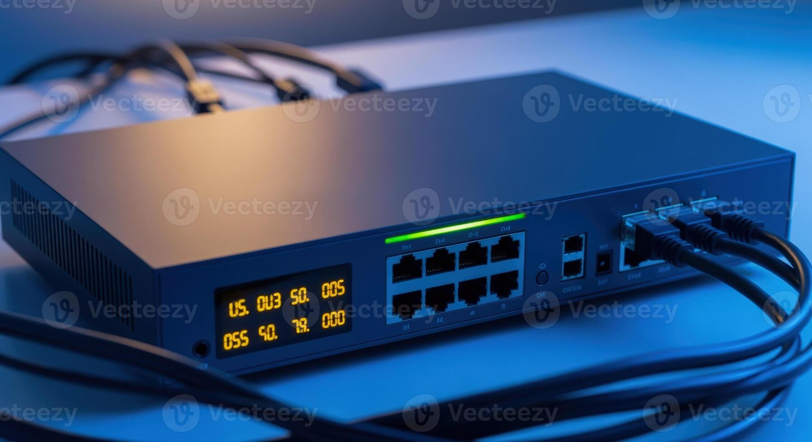
06
CHAPTER 06
Dynamic Host Configuration Protocol
Automating IP address assignment
and network configuration

Slide 22
DHCP — Automating Network Configuration
CHAPTER 06
DHCP is a network management protocol that automatically assigns IP addresses and configuration settings. It operates at the Application Layer using UDP ports 67 (server) and 68 (client).
DHCP Server
DHCP Client
DHCP Relay
Manages IP address pools and assigns configuration. Typically a router or dedicated server. Tracks lease durations and available addresses.
Any device requesting IP configuration: PCs, mobile devices, printers, IoT devices. Automatically discovers and requests settings.
Forwards DHCP messages between clients and servers across different subnets. Enables a single server to serve multiple network segments.
PARAMETERS PROVIDED BY DHCP
IP Address
Unique host identifier
Subnet Mask
Network boundary
Default Gateway
Router for external access
DNS Server
Domain resolution
Lease Time
Address validity period
Benefits: Eliminates manual IP configuration, prevents address conflicts, enables efficient address reuse, and simplifies network administration.
22

Slide 23
The DORA Process — How DHCP Works
CHAPTER 06
1
2
3
4
DISCOVER
OFFER
REQUEST
ACK
Client broadcasts DHCPDISCOVER message to locate available servers. Sent as broadcast since client doesn't know the server address yet.
Server responds with DHCPOFFER containing proposed IP, subnet mask, gateway, DNS, and lease duration.
Client selects one offer and broadcasts DHCPREQUEST to confirm acceptance and inform other servers.
Server sends DHCPACK to finalize the lease and deliver full configuration.
ADDITIONAL DHCP MESSAGES
DHCPNAK
DHCPRelease
DHCPInform
Negative acknowledgment — server rejects the client's request.
Client returns IP to server before lease expires.
Client requests settings without obtaining a new IP.
Lease renewal: At 50% of lease time, the client attempts to renew. At 87.5%, it broadcasts a new DHCPREQUEST. If expired, the DORA process restarts.
23

Slide 24
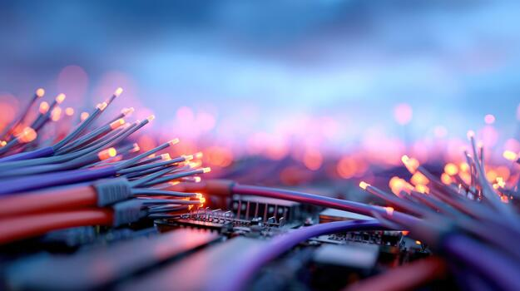
07
CHAPTER 07
Private IP Addresses
Reserved address spaces for
internal networks

Slide 25
RFC 1918 — Private IP Address Ranges
CHAPTER 07
RFC 1918 defines three ranges of IPv4 addresses reserved for private networks. These addresses are not routable on the public Internet.
CLASS A
CLASS B
CLASS C
10.0.0.0 / 8
172.16.0.0 / 12
192.168.0.0 / 16
10.0.0.0 — 10.255.255.255
Prefix: 10.0.0.0/8
Addresses: 16,777,216
Suitable for very large organizations
172.16.0.0 — 172.31.255.255
Prefix: 172.16.0.0/12
Addresses: 1,048,576
Suitable for medium-sized organizations
192.168.0.0 — 192.168.255.255
Prefix: 192.168.0.0/16
Addresses: 65,536
Commonly used in home and small office networks
Why Private IP Addresses?
Private IP addresses help conserve the limited IPv4 address space. With only ~4.3 billion IPv4 addresses available, NAT allows billions of devices to share a much smaller pool of public addresses. Organizations can freely use private addresses internally without coordination with IANA.
25

Slide 26

08
CHAPTER 08
Network Address Translation
Bridging private networks to
the public Internet

Slide 27
NAT — Translating Private to Public IPs
CHAPTER 08
HOW NAT WORKS
BENEFITS OF NAT
1
Outgoing: Device sends packet with private IP. NAT router replaces the private source IP with its public IP before forwarding to the Internet.
Conserves IPv4 Addresses — Multiple devices share one or few public IPs
Security — Hides internal network structure from external view
2
Incoming: Response arrives at router's public IP. NAT looks up its translation table and replaces the public IP with the correct private IP.
Flexibility — Internal IP changes don't affect external communication
Traffic Filtering — Controls which internal addresses access external networks
NAT TERMINOLOGY
Term | Definition
Inside Local | Private IP of the internal host
Inside Global | Public IP representing internal hosts
Outside Global | Public IP of external hosts
Outside Local | External IP as seen from inside
NAT is implemented on routers, firewalls, and dedicated NAT devices. It operates at the network layer (Layer 3) of the OSI model.
27

Slide 28
Types of NAT — Static, Dynamic & PAT
CHAPTER 08
STATIC NAT
DYNAMIC NAT
PAT / NAT OVERLOAD
One-to-One Mapping
One-to-Many (Pool)
Many-to-One (Ports)
Each private IP is permanently mapped to one public IP. Used for servers that must be accessible from the Internet (web servers, email servers).
Maps private IPs to a pool of public IPs temporarily. Public IPs are assigned as needed and returned to the pool when sessions end.
Allows multiple private IPs to share a single public IP using different port numbers. Most commonly used NAT type today.
✓ Simple and predictable
✓ Allows inbound connections
✓ More efficient than Static NAT
✓ Suitable for limited users
✓ Highly cost-effective
✓ Supports thousands of users
✗ Requires one public IP per device
✗ Not cost-effective for large networks
✗ Still requires multiple public IPs
✗ New requests denied if pool exhausted
✗ Can break some applications
✗ No direct inbound connections
Most Common: PAT (NAT Overload) is used in virtually all home networks and most enterprise networks because it maximizes the efficiency of limited public IPv4 addresses.
28

Slide 29
KEY TAKEAWAYS
The TCP/IP protocol suite with its four layers forms the backbone of Internet communication
Each layer has specific functions — from physical transmission to user services
DHCP automates IP configuration, saving time and preventing conflicts
Private IPs and NAT enable billions of devices to connect with limited IPv4 space
APPLICATIONS OF INFORMATION AND COMMUNICATION TECHNOLOGIES — WEEK 7

